Slide 1



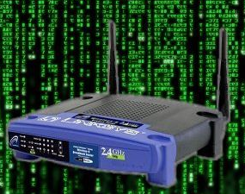
Embebed Systems
Firmware Extraction, Backdooring, explotation
By Deano B00091839@student.itb.ie

Slide 2

!!! WARNING !!!
I and the Hacker Soc will not be responsible for your mistakes or actions with the information you will learn from this or any talks or workshops you participate in.

Slide 3


What Are Embedded Systems
“An embedded system is a computer system with a dedicated function within a larger mechanical or electrical system, often with real-time computing constraints. It is embedded as part of a complete device often including hardware and mechanical parts” – Wikipedia
What Has Embedded Systems
Routers
Watches
Phones
Pace Makers
Clocks
TVs
Insulin Pumps

Slide 4
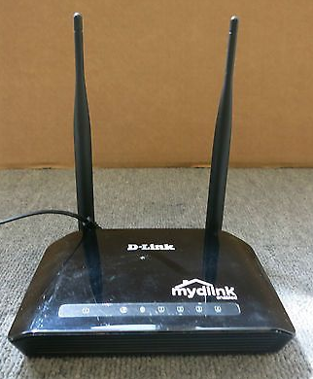
Pre Setup
Target – D-Link DIR-605L Router ~~>
Tools “Firmware Mod Kit” tinyurl.com/yb5pagfy
sudo apt-get install git build-essential zlib1g-dev liblzma-dev python-magic
to start look inside the Firmware Mod Kit folder that you downloaded and run the .sh file

Slide 5
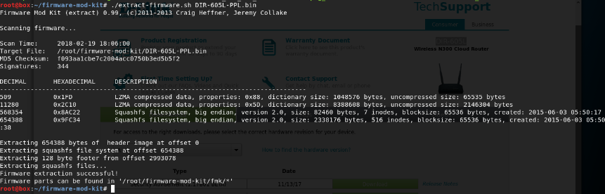
Firmware Extraction & Inspection
Firmware extraction successful!
Now we can go ahead and the inspection attempting to find any week points.

Slide 6
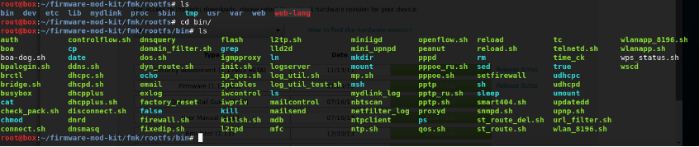
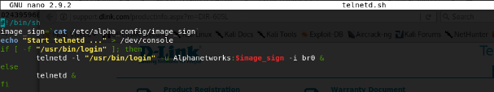
Backdooring Embedded Systems
what were typically looking for is any weak default configuration that would allow us to gain access to the router remotely and hopefully gain shell on it, if we can exploit one… we can exploit them all
Looking at the bin file
Looking trough the files we find a file called telnetd.sh lets open it and have a look
Username : Alphanetworks
Password : Read from /etc/alpha_config/image_sign file

Slide 7

Cat /etc/alpha_config/image_sign file
Looking inside the file that was marked as the password file we find this
We now have the username and password
Username : Alphanetworks
Password : wrgn35_dlwbr_dir605l
This can allow us to remote into the router via Telnet and get full shell access to the router.
The next stage would be to write a automated script using massscan to scan the IPv4 range to find this version of the router with default creds… to advanced on this we could add automated backdooring of the router

Slide 8
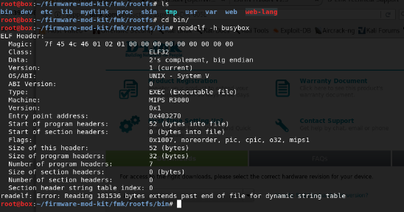
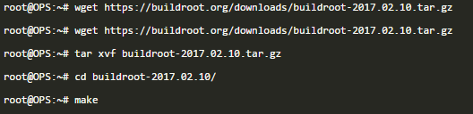
Vulnerability & Exploitation
To build a Backdoor we first need to see the architecture the firmware uses /bin/buysbox
the file is MIPS/big endian so our backdoor shell needs to be in the same.
Before continuing we need to download and install buildroot
Bellow at the steps for this

Slide 9
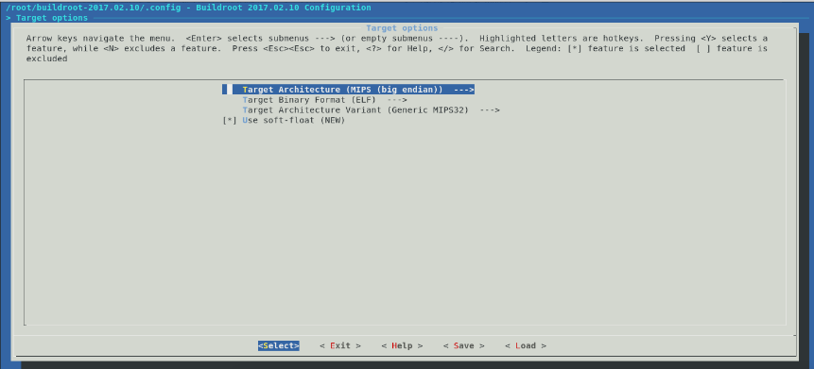
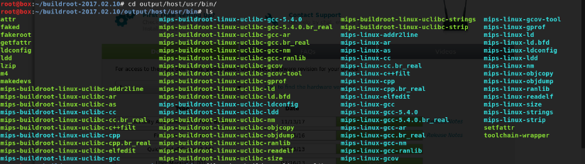
When you Run Buildroot you will see the bellow
After selecting the target architecture save the changes and exit then initiate the make command again and it should start building it

Slide 10
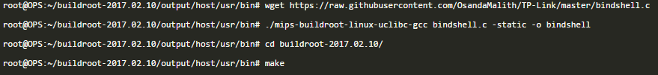
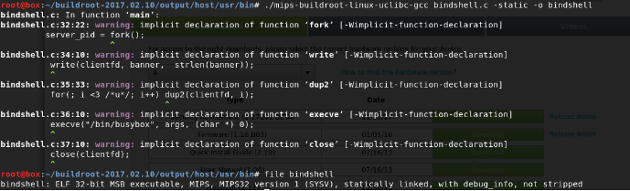
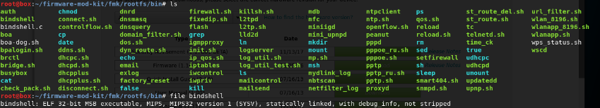
Now we are able to proceed with compiling the following bindshell https://raw.githubusercontent.com/OsandaMalith/TP-Link/master/bindshell.c, for that we initiate the following commands :
Once compiled we move the binary file to the bin/ directory
Now we move the binary to the bin/ directory inside the firmware's filesystem

Slide 11
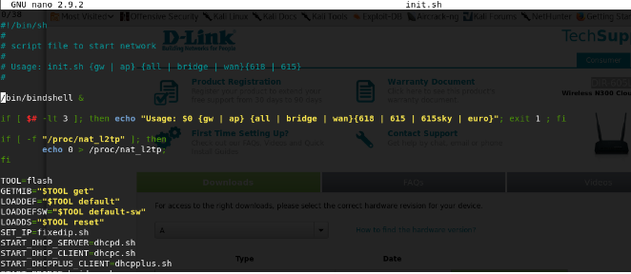
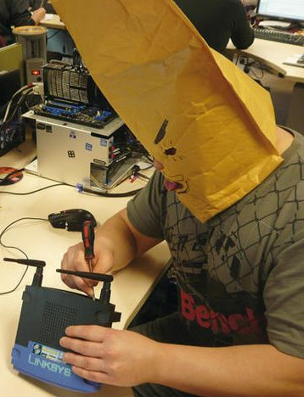

Finally for it to get executed on router boot we insert the following command inside bin/init.sh file which is executed on boot as well
Now that everything is setup we recompile the firmware with those changes using the firmware-mod-kit, keep in mind that the toolkit will work on files that are inside fmk/ directory and this whole time we were modifying the firmware that we extracted in the previous chapter and it was inside that directory (i.e : fmk/)
Once the recompiling is done we should see the new firmware located in fmk/new-firmware.bin
Firmware Backdoored, we can no feed it to the router and remote connect to our blind shell on port 9999

Slide 12
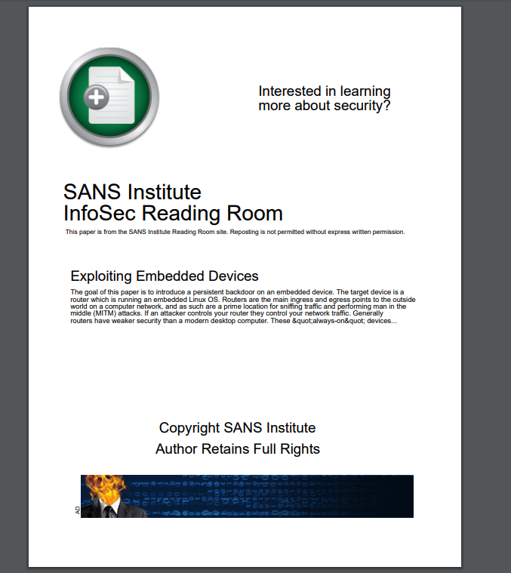
Further Reading

Slide 13


